Slide 1


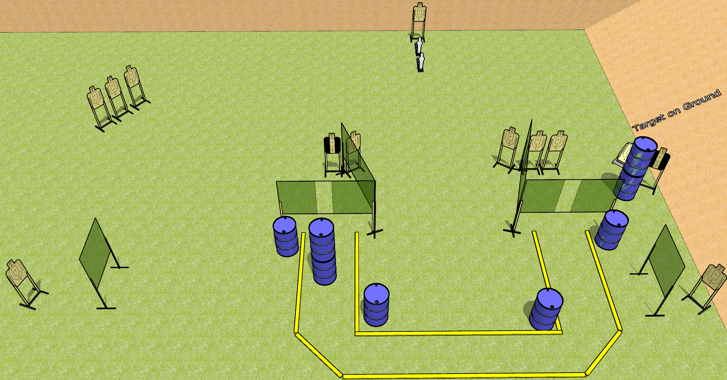
 | Dothan Gun Club – USPSA Match Droppin Mags Course Designer : Drew Coleman
Round Count 28 rounds 13 USPSA targets 2 mini poppers
Equipment List 12 wall feet 2 medium fault lines 2 tuxedos Use 10’ fault lines for the parts leading away from the ports, separate the inner 10’s by 16’ minimum

Slide 2
Droppin Mags
Written Stage Briefing
Droppin Mags is a 28 round, 140 point, Comstock course of fire. There are 13 USPSA targets and 2 mini poppers. The best 2 hits on paper will score, and steel must fall to score. The start signal is audible.
Start position is anywhere inside the shooting area, wrists below belt. Firearm is unloaded laying unpropped on any barrel. All magazines to be used on stage must start on any other barrel or barrels.
On start signal, engage targets as they become available from within the shooting area.

